Slide 1

19ECS305 CRYPTOGRAPHY AND NETWORK SECURITY

Slide 2
MODULE 1 Introduction

Slide 3
MODULE 1
Introduction: Computer Security Concepts, The OSI Security Architecture Cryptography, cryptanalysis, attacks, services, security mechanisms.
Classical Encryption Techniques: Substitution Techniques, Caesar Cipher, Monoalphabetic Ciphers, Playfair Cipher, Hill Cipher, Polyalphabetic Ciphers. Transposition Techniques.

Slide 4
COMPUTER SECURITY CONCEPTS

Slide 5

Computer Security Concepts
Computer Security
The protection afforded to an automated information system in order to attain the applicable objectives of preserving the integrity, availability, and confidentiality of information system resources.

Slide 6
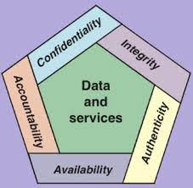
Objectives of Computer Security
Confidentiality
Data confidentiality
Privacy
Integrity
Data integrity
System integrity
Availability
Additional objectives:
Authenticity
Accountability

Slide 7
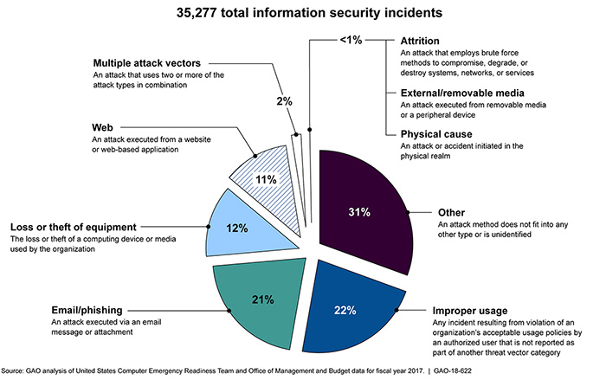
The Challenges of Computer Security

Slide 8
OSI SECURITY ARCHITECTURE

Slide 9
OSI Security Architecture
The OSI security architecture is useful to managers as a way of organizing the task of providing security.
The OSI security architecture focuses on
Security attacks
Mechanisms
Services

Slide 10
CRYPTOGRAPHY AND CRYPANALYSIS

Slide 11




Why Cryptography is important?
Hacker
Hi Bob send me Rs. 10000 please.
Hi Bob, how are you?
Alice
Bob

Slide 12

What is Cryptography?
Cryptography refers to set of techniques used to protect the integrity of networks, program and data from attack, damage or unauthorized access.

Slide 13

How Cryptography works?
Hacker
34568798
Error / Original Text
Hi Bob, how are you?
Alice
Bob

Slide 14
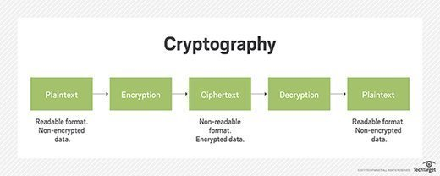




Plain Text
Encryption
Hi, How are you?
34567843
Key
Cipher Text
34567843
Hi, How are you?
Key
Plain Text
Decryption

Slide 15
Cryptanalysis
Cryptography :The area of study used for encryption
Cryptanalysis : The area of study used for decrypting a message without any knowledge of encryption details.
Cryptology : The areas of cryptography and cryptanalysis together

Slide 16
SECURITY ATTACKS

Slide 17
SECURITY ATTACKS
Passive attacks: It attempts to make use of information from the system but does not affect system resources.
Release of Message contents
Traffic Analysis
Active attacks: It attempts to alter system resources or affect their operation.
Masquerade
Replay
Modification
Denial of Service

Slide 18
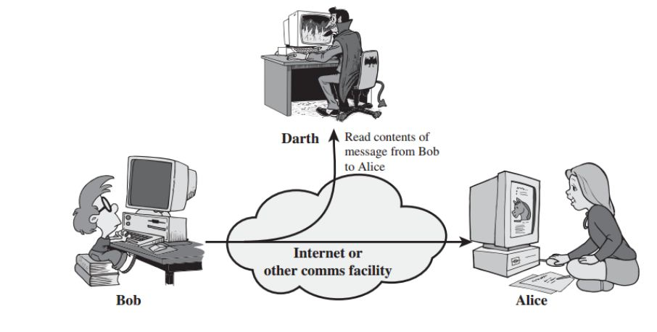
Passive Attack: Release of Message contents
A telephone conversation, an e-mail message and a transferred file may contain sensitive or confidential information.

Slide 19
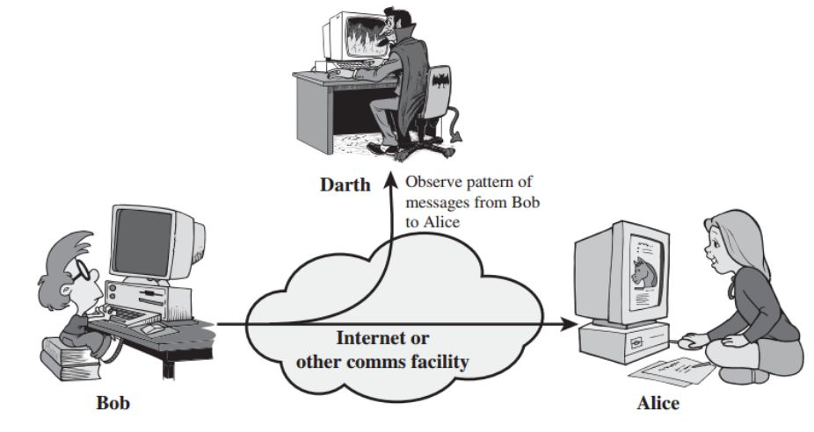
Passive Attack: Traffic Analysis
Encryption technique can be used to mask the content of messages so that opponents, even if they captured the message, could not extract the information from message.

Slide 20
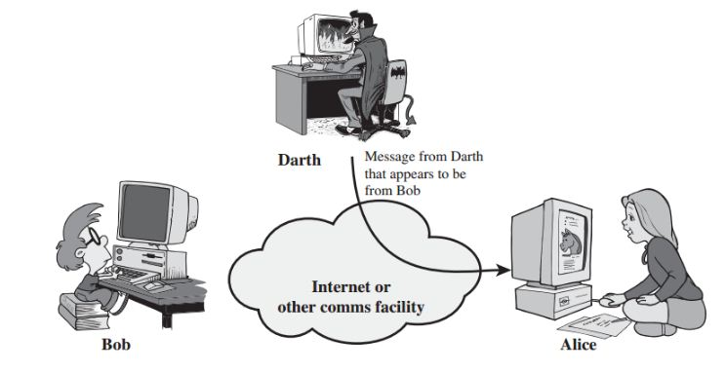
Active Attack: Masquerade
One entity pretends to be a different entity

Slide 21
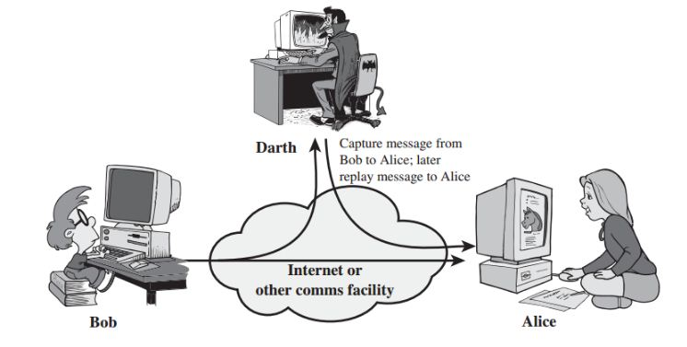
Active Attack: Replay
It involves the passive capture of the data unit and its subsequent retransmission to produce an unauthorised effect

Slide 22
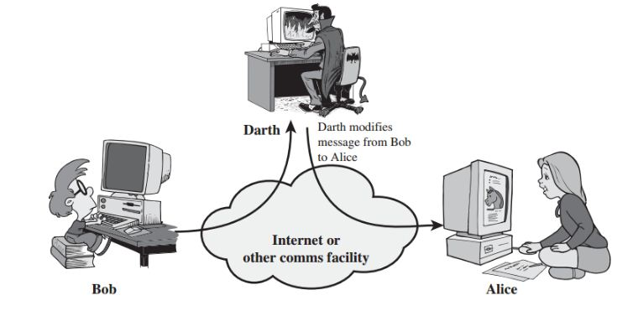
Active Attack: Modification of Messages
Some portion of a legitimate message is altered, or that messages are delayed or reordered

Slide 23
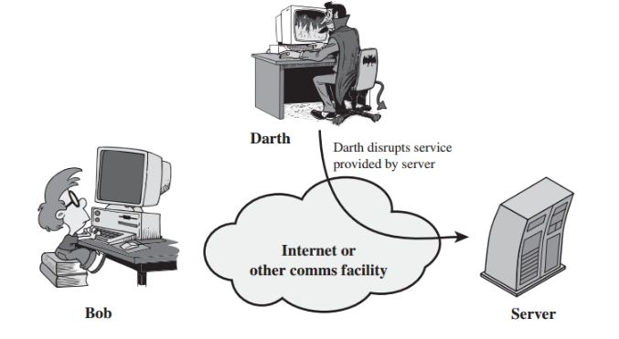
Active Attack: Denial of Service
It prevents the normal use or management of communications

Slide 24
SECURITY SERVICES

Slide 25
SECURITY SERVICES
A processing or communication service that enhances the security of the data processing systems and the information transfers of an organization.
Confidentiality
Integrity
Authentication
Messages
Non repudiation
Security Services
Access control
Availability
Entity
Authentication

Slide 26
Security Services | Security Mechanisms
Data Confidentiality | Encipherment and Routing Protocol
Data Integrity | Encipherment, digital signature and data integrity
Authentication | Encipherment, digital signature and authentication exchange
Non repudiation | Digital signature, data integrity and notarization
Access Control | Access control mechanism.

Slide 27
-> Authentication:
Cryptography can provide two types of authentication services:
Integrity authentication can be used to verify that non-modification has occurred to the data.
Source authentication can be used to verify the identity of who created the information, such as the user or system.
Ensures that the origin of a message or electronic document is correctly identified, with an assurance that the identity is not false.
Peer Entity Authentication:
Data-Origin Authentication:

Slide 28
-> Data Confidentiality:
Protects data from unauthorized disclosure.
Ensures that the information in a computer system and transmitted information are accessible only for reading by authorized parties.
-> Integrity
The assurance that data received are exactly as sent by an authorized entity. (i.e., contain no modification, insertion, deletion, or replay).
Modification includes writing, changing status, deleting, creating and delaying or replaying of transmitted messages.

Slide 29
-> Non repudiation:
Requires that neither the sender nor the receiver of a message be able to deny the transmission.
Proof of Origin: Proof that the message was sent by the specified party.
Proof of Delivery: Proof that the message was received by the specified party.
-> Access control:
Requires that access to information resources may be controlled by or the target system.
controls who can have access to resource under what condition.

Slide 30
-> Availability:
Requires that computer system assets be available to authorized parties when needed.
Available to authorized entities for 24/7.
-> Authorization:
Authorization provides permission to perform a security function or activity.
Authorization is generally granted after the successful execution of a source authentication service.

Slide 31
SECURITY MECHANISMS

Slide 32
Security Mechanisms
Feature designed to detect, prevent or recover from a security attack.
Security Mechanisms
Specific Security Mechanisms
(8 Types)
Pervasive Security Mechanisms
(5 Types)

Slide 33
Encipherment
Digital Signature
Access Control
Specific Security Mechanisms
Data Integrity
Authentication Exchange
Traffic Padding
Routing Control
Notarization

Slide 34
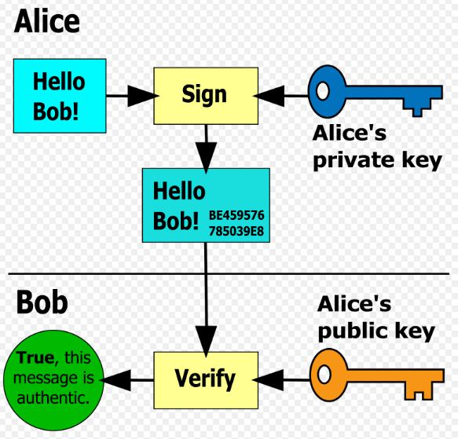
Encipherment
The use of mathematical algorithms to transform data into a form that is not readily intelligible.
Digital Signature
Data appended to, or a cryptographic transformation of a data unit that allows a recipient of the data unit to prove the source and integrity of the data unit and protect against forgery (e.g., by the recipient).

Slide 35
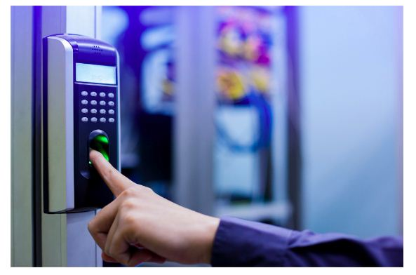
Access Control
A variety of mechanisms that enforce access rights to resources.
Data Integrity
A variety of mechanisms used to assure the integrity of a data unit or stream of data units.
Truthful
Verifiable
Accurate
Data Integrity
Retrievable
Complete

Slide 36
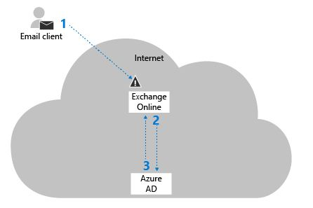
Authentication Exchange
A mechanism intended to ensure the identity of an entity by means of information exchange.
Traffic Padding
The insertion of bits into gaps in a data stream to frustrate traffic analysis attempts.

Slide 37
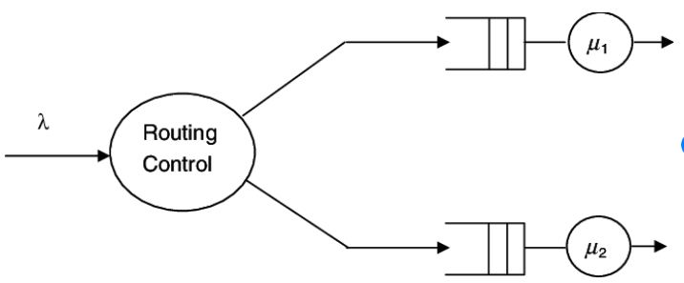

Routing Control
Enables selection of particular physically secure routes for certain data and allows routing changes, especially when a breach of security is suspected.
Notarization
The use of a trusted third party to assure certain properties of a data exchange.

Slide 38
Pervasive Security Mechanisms
Trusted Functionality
That which is perceived to be correct with respect to some criteria (e.g., as established by a security policy).
Security Label
The marking bound to a resource (which may be a data unit) that names or designates the security attributes of that resource.
Event Detection
Detection of security-relevant events.
Security Audit Trail
Data collected and potentially used to facilitate a security audit, which is an independent review and examination of system records and activities.
Security Recovery
Deals with requests from mechanisms, such as event handling and management functions, and takes recovery actions.

Slide 39
CLASSICAL ENCRYPTION TECHNIQUES

Slide 40
Classification of Cryptography
Cryptography
Symmetric Key Cryptography
Asymmetric Key Cryptography
Classical Cryptography
Modern Cryptography
Transposition Cipher
Substitution Cipher
Stream Cipher
Block Cipher

Slide 41
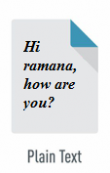
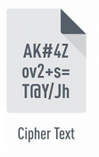





Symmetric Key Encryption

Slide 42
Basic Terminologies of Cryptography
Referred Conventional / Private-key / Single-key
which uses the same key used by the sender to encrypt the message and by the receiver to decrypt the message.
Cipher Text
the encrypted data
Cipher
the mathematics (or algorithm) responsible for turning plaintext into ciphertext and reverting ciphertext to plaintext
Key
a key is a string of characters used within an encryption algorithm for altering data so that it appears random.

Slide 43
Basic Terminologies of Cryptography
Encipher (Encrypt)
Encoded text
Decipher (Decrypt)
Decoded text or Plaintext
Cryptography
The art and science of concealing the messages to introduce secrecy in information security is recognized as cryptography.
Cryptanalysis (Code Breaking)
is the process of studying cryptographic systems to look for weaknesses or leaks of information.
Cryptology
the scientific study of cryptography and cryptanalysis

Slide 44
Classical Encryption Techniques
Substitution Techniques
Replaces the plaintext characters with other characters, numbers and symbols.
Transposition Techniques
Rearranges the position of the characters of the plaintext.

Slide 45
SUBSTITUTION TECHNIQUES

Slide 46
Substitution Techniques
Caesar Cipher
Monoalphabetic Ciphers
Playfair Cipher
Hill Cipher
Polyalphabetic Ciphers

Slide 47
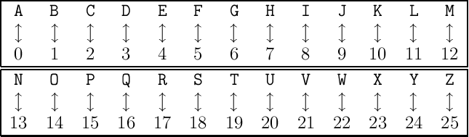

1. Caesar Cipher
Earliest and simplest method of encryption technique
Replaces each letter of alphabet with the letter standing three places further down the alphabet

Slide 48
Caesar Cipher Algorithm
Encryption: C = E(k, p ) = (p + k )mod 26
Decryption: P = D (k, C) = (C – k) mod 26
Example 1: key=3
plaintext: hello how are you
ciphertext: KHOOR KRZ DUH BRX

Slide 49
Example
Example 3: Text : ATTACKATONCE
Shift: 4
Cipher: EXXEGOEXSRGI
Example 2: Plain text: pay more money
Key =3
Cipher text: SDB PRUH PRQHB

Slide 50
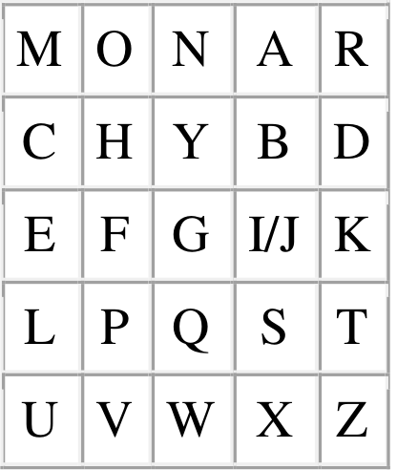
2. Playfair Cipher
The best-known multiple letter encryption cipher is the Playfair.
The Playfair treats digrams in the plaintext as single units and translates these units into cipher text diagrams.
The Playfair algorithm is based on the use of 5x5 matrix of letters constructed using a keyword.
The matrix is constructed by filling in the unique letters of the keyword, and then filling in the remaining letters in alphabetic order.

Slide 51


Rules of Playfair Cipher
Pair cannot be made with same letter. Break the letter and fill with filler letter ‘x’.
If the letter is standing alone in the process of pairing, then add an extra filler letter ‘z’ with the alone letter.

Slide 52
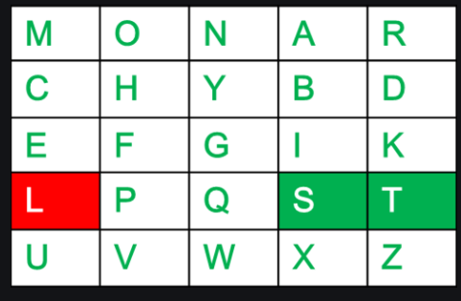

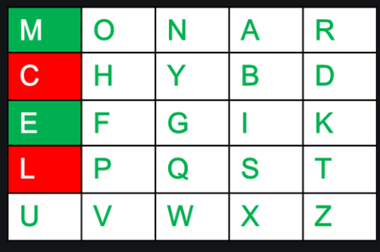

Rules of Playfair Cipher
Two plaintext letters that fall in same row of the matrix are each replaced by the letter to the right.
Two plaintext letters that fall in the same column are each replaced by the letter beneath.

Slide 53
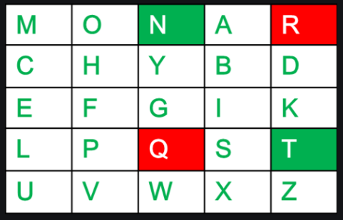

Rules Playfair Cipher
Otherwise, each plaintext letter in a pair is replaced by the letter that lies in own row and the column occupied by the other plaintext letter.

Slide 54
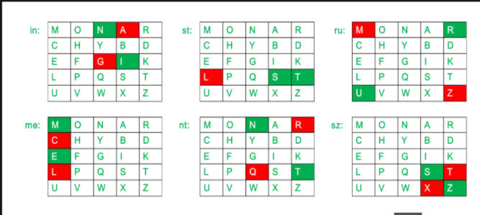
Playfair Cipher :Example 1
Key: MONARCHY
Plaintext: INSTRUMENTS
Plaintext: IN ST RU ME NT SZ
Ciphertext: GA TL MZ CL RQ TX

Slide 55
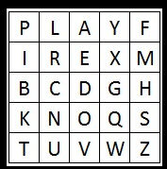
Playfair Cipher : Example 2
Key: PLAYFAIR EXAMPLE
Plaintext: HIDE THE GOLD IN THE TREE STUMP
Plaintext: HI DE TH EG OL DI NT HE TR EX ES TU MP
Ciphertext: BM OD ZB XD NA BE KU DM UI XM MO UV IF

Slide 56
Strength of Playfair Cipher
Playfair cipher is a great advance over simple mono alphabetic ciphers.
Since there are 26 letters, 26x26 = 676 diagrams are possible, so identification of individual diagram is more difficult.

Slide 57
3. Monoalphabetic Ciphers
A single cipher alphabet (mapping from plaintext to ciphertext) is used per message.
It has a fixed replacement structure.
Each plaintext letter maps to a different random ciphertext letter
The substitution is fixed for each letter of the alphabet.
Eg: Thus, if "a" is encrypted to "R", then every time we see the letter "a" in the plaintext, we replace it with the letter "R" in the ciphertext.

Slide 58
4. Hill Cipher
Hill cipher is a polygraphic substitution cipher based on linear algebra.
Each letter is represented by a number modulo 26.
To encrypt a message, each block of n letters is multiplied by an invertible n × n matrix, against modulus 26.
Encryption: PK mod 26
To decrypt the message, each block is multiplied by the inverse of the matrix used for encryption.
Decryption: CK⁻¹ mod 26

Slide 59
Hill Cipher: Example 1
Input : Plaintext: ACT
Key: GYBNQKURP
Output : Ciphertext: POH
Encryption
We have to encrypt the message ‘ACT’ (n=3).The key is ‘GYBNQKURP’ which can be written as the n X n matrix:

Slide 60
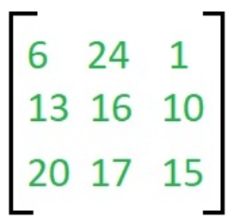
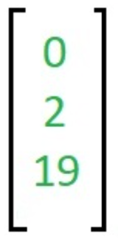
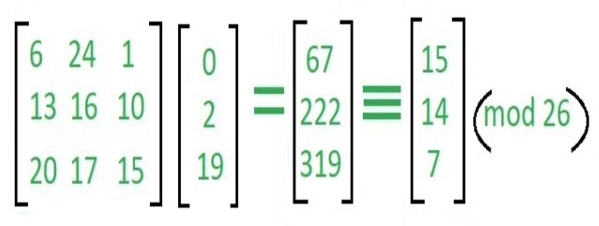
Hill Cipher: Example 1
The message ‘ACT’ is written as vector:
The enciphered vector is given as:
which corresponds to ciphertext of ‘POH’

Slide 61
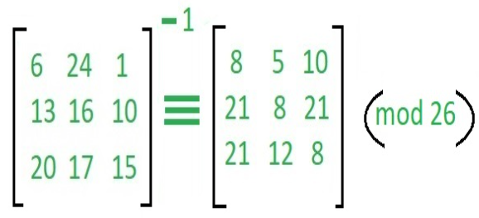
Hill Cipher: Example 1
Decryption:
To decrypt the message, we turn the ciphertext back into a vector, and then simply multiply by the inverse matrix of the key matrix.

Slide 62
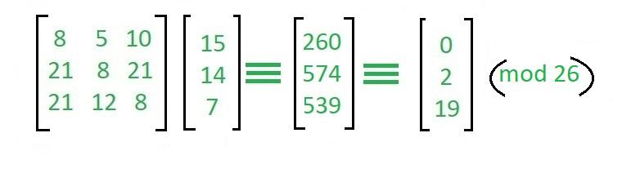
Hill Cipher: Example 1
Decryption:
For the previous Ciphertext ‘POH’:
Which gives us back ‘ACT’.

Slide 63
Hill Cipher: Example 2
Input : Plaintext: SHORT EXAMPLE
Key: HILL
Output : Ciphertext: APADJTFTWLFJ

Slide 64
Polyalphabetic Cipher
A set of related monoalphabetic substitution rules are used.
A key determines which particular rule is chosen for a given transformation.

Slide 65


Polyalphabetic Cipher: Vigenere Cipher
Best and simplest Polyalphabetic cipher.
Encryption:
Decryption:
To encrypt a message, a key is needed that is as long as the message

Slide 66
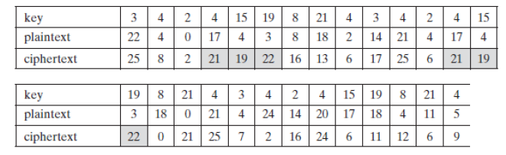
E_{i} = (P_{i} + K_{i}) mod 26
Vigenere Cipher Example
Plaintext: WE ARE DISCOVERED SAVE YOURSELF
Key: DECEPTIVE
Ciphertext: ZICVTWQNGKZEIIGASXSTSLVVWLA
In the above example, two instances of sequence "red" are separated by 9 character positions. Thus in both cases, the ciphertext sequence is VTW.

Slide 67

E_{i} = (P_{i} + K_{i}) mod 26
Vigenere Cipher Example
Solution: Autokey System
Keyword is concatenated with the plaintext itself to provide a running key.

Slide 68

Polyalphabetic Cipher: Vernam Cipher
The keyword is chosen as long as the plaintext and has no relationship between them.
Works on binary data(bits) rather than letters.
Encryption:
Ci = Pi XOR Ki
Ci – i th binary digit of cipher text
Pi – i th binary digit of plaintext
Ki – i th binary digit of key
Decryption:
Pi = Ci XOR Ki
XOR operation

Slide 69
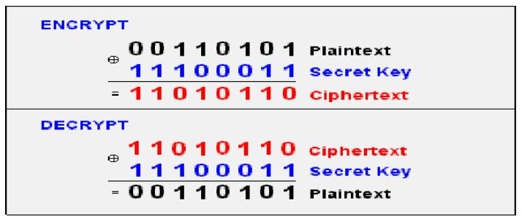
Vernam Cipher Example

Slide 70
TRANSPOSITION TECHNIQUES

Slide 71
Transposition Technique
Performed by permutation on the plain text letters.
Rail Fence
The plaintext is written down as a sequence of diagonals and then read off as a sequence of rows.
The Rail Fence cipher works by writing your message on alternate lines across the page, and then reading off each line in turn.

Slide 72
Encryption
To write your message in zigzag lines across the page, and then read off each row.
Firstly, you need to have a key
You then start writing the letters of the plaintext diagonally down to the right until you reach the number of rows specified by the key.
You then bounce back up diagonally until you hit the first row again.
This continues until the end of the plaintext.

Slide 73
Decryption
The decryption process for the Rail Fence Cipher involves reconstructing the diagonal grid used to encrypt the message.
We start writing the message, but leaving a dash in place of the spaces yet to be occupied.
Gradually, you can replace all the dashes with the corresponding letters, and read off the plaintext from the table.
We start by making a grid with as many rows as the key is, and as many columns as the length of the ciphertext.
We then place the first letter in the top Left Square, and dashes diagonally downwards where the letters will be.
When we get back to the top row, we place the next letter in the ciphertext. Continue like this across the row, and start the next row when you reach the end.

Slide 74

Transposition Technique: Example 1
Plaintext "defend the east wall" is written as shown below, with all spaces removed.
The simplest Rail Fence Cipher, where each letter is written in a zigzag pattern across the page.
The ciphertext is then read off by writing the top row first, followed by the bottom row, to get "DFNTEATALEEDHESWL".

Slide 75
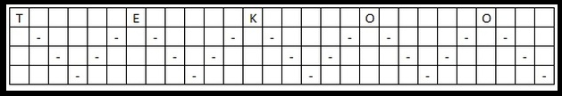
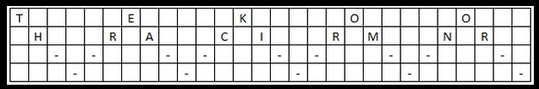
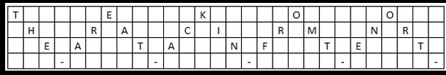

Transposition Technique: Example 2
Ciphertext : “TEKOOHRACIRMNREATANFTETYTGHH”
Encrypted key : 4, you start by placing the "T" in the first square

Slide 76
Columnar Transposition Cipher
The columnar transposition cipher is a fairly simple, easy to implement cipher. It is a transposition cipher that follows a simple rule for mixing up the characters in the plaintext to form the ciphertext.
The key for the columnar transposition cipher is a keyword e.g. GERMAN. The row length that is used is the same as the length of the keyword. To encrypt a piece of text, e.g. defend the east wall of the castle

Slide 77
Key
GERMAN.
Plain Text
defend the east wall of the castle

Slide 78
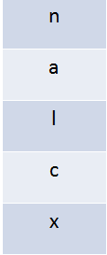
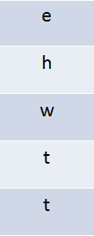
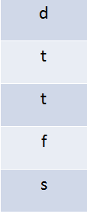
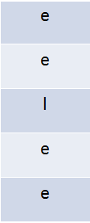
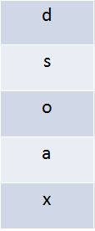
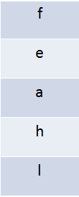
Encrypted a piece of cipher text, e.g. nalcxehwttdttfseeleedsoaxfeahl

Slide 80
Thank You!

